Slide 1
Unit - iii
Theory of Production

Slide 2
Production function -
A manager/economy is faced with the problem of ‘how to produce?’
He has to take a decision about the combination of fixed and variable factors should be employed
He has to decide about the input combination

Slide 3
Production and Production function
Production refers to the process by which man utilizes or converts the resources of nature, so as to satisfy human wants
Production function means transformation of physical inputs into outputs
Refers to the functional relationship between inputs & output under given technology
Mathematically, Q=f (f1,f2……….fn) Q= physical qty. of a certain product. f1,f2= various inputs needed to produce Q.

Slide 4
DEFINITIONS:-
“A production function refers to the functional relationship, under the given technology, between physical rates of input & output of a firm, per unit of time.”
“A production function relates maximum quantity of output that can be produced from given amount of various inputs for given technology.”
- McGuigan & Moyer.

Slide 5
Factors affecting production function -
Technology
Inputs – Land, labour, capital, entrepreneur
Inputs are divided into fixed and variable
Time period of production – Short run and long run

Slide 6
short run & long run production functions
The inputs or factors of production are classified as fixed and variable.
Both short run & long run actually depends on the inputs, which can vary in production
Variable factors / inputs - can be changed in the short-run Ex- labour, electricity, fuel, transportation
Fixed factors / inputs - Cannot be changed during short-run Ex- land, capital, buildings, tools, machinery

Slide 7
Production function with one fixed input & one variable input
We assume at least one input is fixed
Q = f(L, K) K is fixed here
OR
Q = f(K, L) L is fixed here

Slide 8
law of diminishing marginal returns / law of variable proportion
The law basically explains the behaviour of production functions in the short run
“As the proportion of one factor in a combination of factors is increased after a point, the AVERAGE & MARGINAL production of that factor will diminish.”
When more units of variable factors used with the fixed factors a point is reached first MP falls, then the AP & finally the TP will diminish
This law is also called the law of variable proportions because it shows how output varies with variable and fixed inputs

Slide 9
Concept of production
Total product -Total volume of goods & services produced
Average product - Per unit product of a variable product
Marginal product - Net addition to total product

Slide 10
ASSUMPTIONS
Technology will remain constant
Variable factors are homogeneous
Proportion of various productive factors may be combined should be variable
Addition to the variable input is made in equal increment

Slide 11
Law of variable proportion schedule
No of workers | TP | AP | MP | Stage
1 | 2 | 2 | 2 | I stage
2 | 6 | 3 | 4
3 | 12 | 4 | 6
4 | 16 | 4 | 4
5 | 18 | 3.6 | 2 | II stage
6 | 18 | 3 | 0
7 | 14 | 2 | -4 | III stage
8 | 8 | 1 | -6

Slide 12
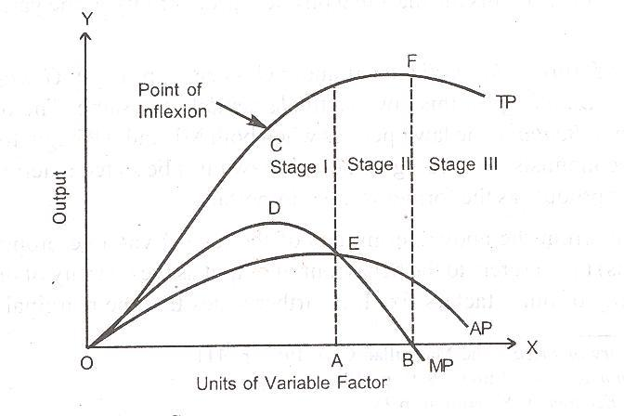

Slide 13
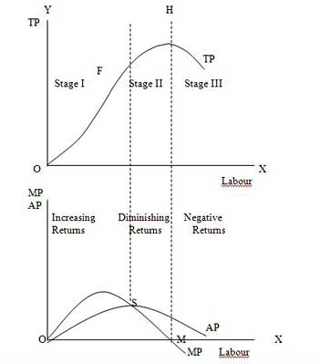

Slide 14
Stages
Stage -1 (IRRATIONAL)
TP increases at an increasing rate
MP also rises
AP also increases but lies below MP
Indivisible fixed factors
Division of labour & specialization
Stage –II (RATIONAL)
TP rises but at a diminishing rate –Maximum
MP falls-Becomes zero
AP also diminish –AP>MP
Optimum utilization of resources.

Slide 15
Stages contd…..
Stage-III (IRRATIONAL)
TP starts declining
MP becomes negative
AP also diminish
Excess variable factor with fixed factors
Universality of law-
Applies to every industry & firm
Operates in agriculture
Negative MP in PSU - SAIL

Slide 16
Law of variable proportion and capacity planning -
Total output decisions of a firm depend on the demand made by the consumers
Production decisions in turn influence the selection of the plant capacity in the short run
To operate in the second stage of increasing returns, the firm has to select the best combination of fixed inputs and variable inputs
Ex – Birla copper and rise in demand for furnaces for power

Slide 17
Review question
Which of the following is most likely an example of production inputs that can be adjusted in the long run, but not in the short run?
Amount of wood used to make a desk.
Number of pickles put on a sandwich.
The size of a McDonald’s kitchen.
The amount of electricity consumed by a manufacturing plant.

Slide 18
Review question
The relationship between hours spent studying (input) and knowledge of economics (output) is positive. However, once you have done 20 hours of studying, an additional hour does not add as much to your knowledge as the first hour did. When you graph the relationship between studying and knowledge, is the resulting line straight or curved? Why?

Slide 19
A shoe factory has 500 employees and produces a thousand pairs of shoes per hour.
The factory hires one new worker. Now, the factory produces 1,002 shoes per hour. Then the factory hires one more worker. Production rises to 1,004 per hour. Does the factory have diminishing, constant, or increasing marginal returns at this level of production?

